Slide 1
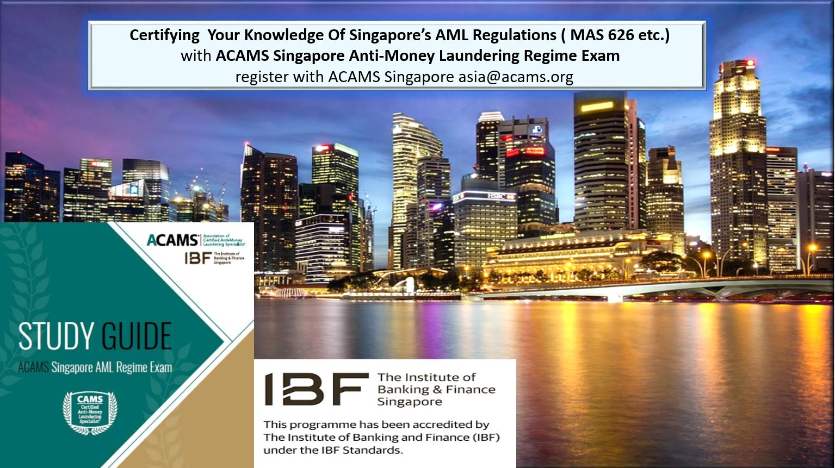

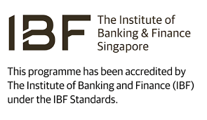
ACAMS in Singapore
CAMS exam is accredited & funded by IBF for citizens and PR’s : 70% to 90%
ACAMS Singapore AML Regime Exam : exams attests to local regulatory knowledge of MAS 626 & ACIP guidelines.
ACAMS Spore Chapter: 4 local chapter events per annum to assist in providing continual professional development for AML & FCC professionals in Singapore.
Annual Singapore Symposium on “international best practice” Tools & Techniques 18th Nov 2019- FTS- IBF funded for Spore citizens and PR’s.

Slide 2
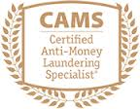
CAMS-IBF Funding Quantum
Who is Eligible? | Funding From IBF | What Can Be Claimed?
S’pore Citizens 40 years and above | 90% | CAMS Certification and ACAMS Singapore AML Regime Exam – USD $ 1,990
S’pore Citizens below 40 years. | 70% | Cannot be claimed: ACAMS membership. Exam Retake Fee. CAMS Recertification CAMS Virtual Class.
S’pore permanent residents. | 70%
ACAMS Singapore AML Regime Exam.
Mandatory to be taken with CAMS to be eligible for IBF refund.
Exam based on MAS 626 and ACIP guidelines and associated Singapore aml regulations.
45 minute MCQ exam.
Psychometrically based questions
Must be taken after CAMS exam passed.
Funding Details:
Funding claims will only be processed upon both CAMS exam and ACAMS Singapore AML Regime Exam being passed.
Both exams will have to be completed within 1 year to be eligible for funding.
IBF will process the refund but full initial fee will have to be paid to ACAMS.
Candidates must currently reside in Singapore to claim refund.

Slide 3
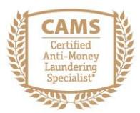
The Certified Anti-Money Laundering Specialist (CAMS)
Course Outline :
Four core competencies covered:
Risks and Methods of Money Laundering Terrorist Financing.
Compliance Standards for Anti-Money Laundering and Combating the Financing of Terrorism.
Anti-Money Laundering Compliance Program.
Conducting or Supporting the Investigation Process
CAMS examination preparation is achieved using a combination of self-study of the electronic CAMS Examination Preparation Study Guide and web-based Training Course, which comprises approximately seven hours of candidate-paced study.
Benefits & Deliverables :
Increases professional skills and knowledge through better understanding of financial crime detection and prevention techniques.
Protecting their institution from money laundering threats and minimize financial crime risks.
Meet mandated AML training requirements through preparation and study.
Proving AML expertise to examiners and regulators.
Candidates will be internationally recognized as CAMS certified after passing CAMS exam; proving Interpol’s commitment to protecting your institution from financial crimes by demonstrating understanding in the field of anti-money laundering, financial crime compliance.

Slide 4
Total Fee Spent & Savings ( including mandatory ACAMS membership)
Normal Rate: CAMS Certification : USD $, 1695 1 year ACAMS membership: USD $295 ACAMS Singapore AML Regime: USD $ 495 | USD $ 2,485
With 70% IBF Refund For Spore citizens below 40 years and PR’s: CAMS Certification ( USD $ 1,495) : USD $ 448.50 1 year ACAMS membership: USD $ 295 ACAMS Singapore AML Regime: USD $ 148.50 | USD $ 892 ( actual fee spent after refund)
With 90% IBF Refund For Spore citizens 40 years and above: CAMS Certification ( USD $ 1,495) : USD $ 149.50 1 year ACAMS membership: USD $ 295 ACAMS Singapore AML Regime: USD $ 49.50 | USD $ 494 ( actual fee spent after refund)

Slide 5
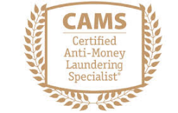
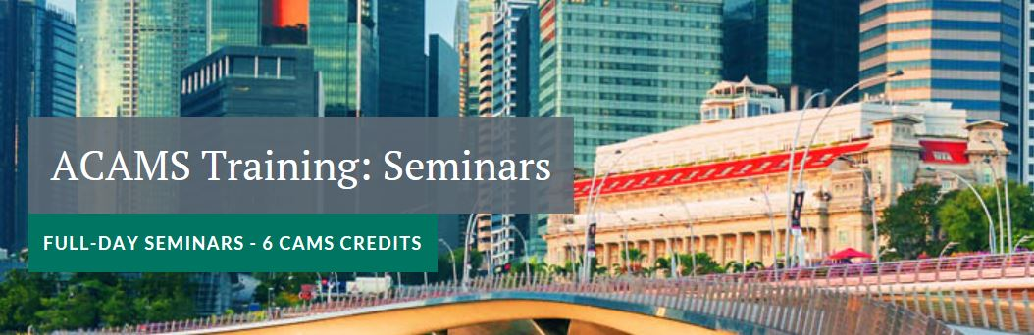

ACAMS 11th Annual Singapore Symposium on AML & FCC Tools and Techniques.
18th November 2019
The Westin, Singapore.
Free 1 Day Live CAMS + ACAMS Spore AML Regime Exam Prep- Sunday 17th Nov 2019 for attendees registered for CAMS.
Regulatory Update: Analyzing Regional AML Regulatory New Trends and Developments;
Crafting Processes to Combat Illicit Money Flows in the APAC Region.
FinTech Update: Strengthening Electronic Payment Systems with New Technologies to Mitigate Abuse.
Developing a Better Culture of Compliance within the Casino Industry.
Interactive Afternoon Workshop:
Digital Identity and e-KYC: How to Look at the Growing Technology Requirements and Financial Crime-related Risks.
50 % funding for Spore citizens under 40 yrs and PR’s.
90 % funding for Spore citizens over 40 yrs of age.
Company sponsored attendees only.

Slide 6
Free 1 Day CAMS Exam + ACAMS Spore AML Regime Exam Preparation Sunday 17th November 2019 The Westin, Singapore
For current CAMS Registered candidates attending the ACAMS Spore Symposium on the 18th of September 2019.
9 am to 6 pm; breakfast, lunch and beverages provided.
1st time revision and live training on both CAMS exam and ACAMS Singapore AML Regime Exam.
Practice mock exam questions.
Takeaway notes provided of session.
2 ACAMS certified tutors will conduct the class and answer questions and discuss exam techniques.
For non- symposium attendees the fee will be at USD $ 350.

Slide 7
Attendance Fee For Spore Symposium 2019 With FTS-IBF Funding
*Only company sponsored Singapore citizens and permanent residents are eligible for this FTS-IBF funding. Refund will be issued after attending event. | For ACAMS members | For Non-ACAMS members
For all non- Singapore citizens and PR’s rate: | USD $ 625 | USD $ 695
For Singapore Citizens 40 years and above. 90% after refund. | USD $ 62.50* | USD $ 69.50*
For Singapore Citizens below 40 years and permanent residents. 50% after refund. | USD $ 312.50* | USD $ 208.50*

Slide 8
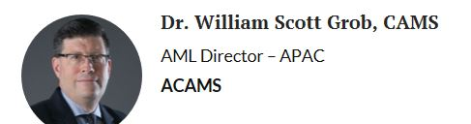
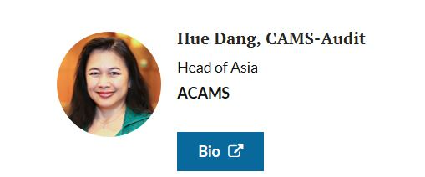
CAMS & ACAMS Spore AML Regime Trainers
Dr Grob has over 25 years experience in banking and finance. His most recent role was Regional Head of Affiliates Management for HSBC where he worked on mitigating financial crime and correspondent banking risks. His 12 year career with HBSC also included managing risk within the Equity/ FX Prime brokerage business, structured funds business and hedge fund business.
Dr.Grob earned a Bachelor’s degree from Boston University, Masters from George Mason University, a certificate from Harvard Business School’s General Management program and Doctorate of Management from SMC University ( USA) where his dissertation focussed on “ Impact of Correspondent Bank Enhanced Due Diligence Practices.” He also has designations from Chartered Alternative Investment Analyst (CAIA) and Global Association of Risk Professionals ( FRM).
Ms.Hue Dang is the Head of ACAMS Asia, establishing the head office in Hong Kong in 2008. Ms. Dang has more than 20 years in banking and finance. Prior to ACAMS, she was a bank examiner at the Federal Reserve Bank, Boston, USA; manager at Barclay’s Capital Investment Banking Division in Singapore, Director for Business Development for Citibank’s Consumer Banking Group in Singapore.
Hue has a Bachelor’s degree with Honours from Amherst College and Masters in Public Policy from the John F Kennedy School of Government from Harvard University.

Slide 9
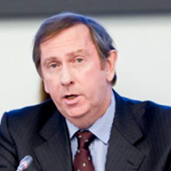
ACAMS Special Advisor To South East Asia Training Faculty
Rick McDonell
Former Executive Secretary Financial Action Task Force and current Executive Director of ACAMS.
Mr. McDonell was the Executive Secretary of the FATF since 2007.Prior to that he worked for the United Nations Office On Drugs and Crime (UNODC), where he was Chief of the UN Global Programme on Money Laundering.
Previously Rick established the Asia Pacific Group on Money Laundering and became its first Executive Secretary.
He is a lawyer by training and has had extensive experience as a federal prosecutor and in conducting complex investigations including being in charge of many multidisciplinary investigation Task Forces into organised crime cases both nationally and internationally. He also has had experience in private legal practice and as a university lecturer.

